Slide 1


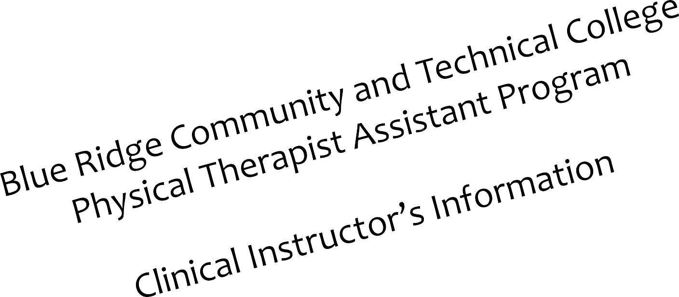


Slide 2
Goals & Objectives
Describe The PTA Program
Explain The Roles & Responsibilities of the “Clinical Instructor (CI)”
Reviewing PTA clinical paperwork
Contacts for questions or concerns

Slide 3
Clinical Instructor’s Roles
Resource – provide knowledge from a field experience not available to student
Have had 1 year experience
Supervisor – Oversee treatment, evaluate skill and knowledge level
Coach – Cheer success, encourage improvement, provides guidance for positive patient care.

Slide 4
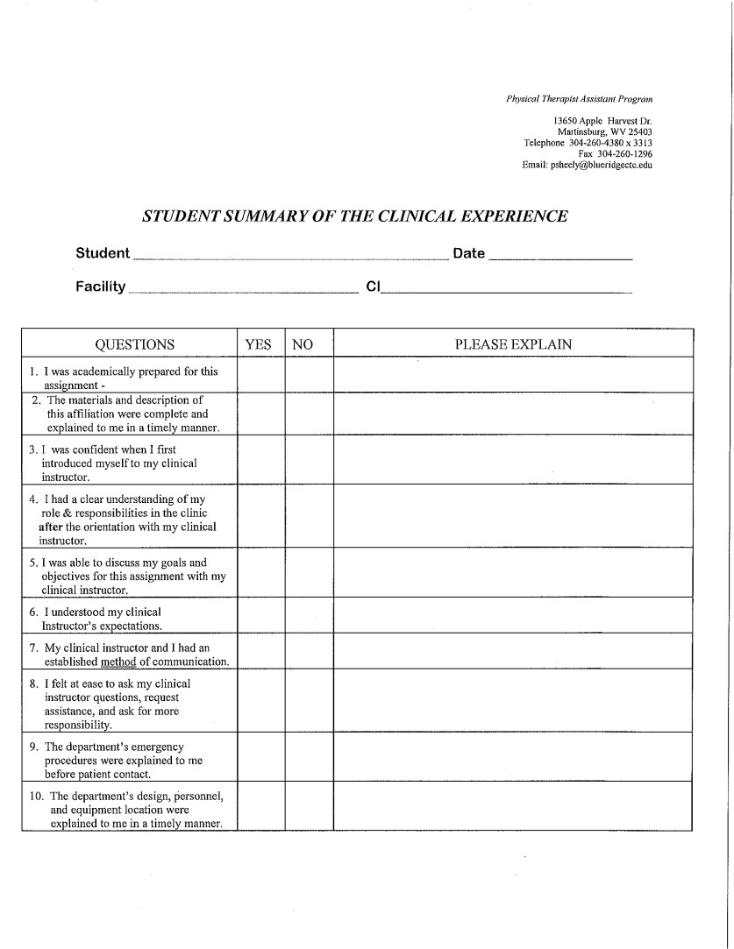
Student Summary of Clinical Experience
Site Evaluation
The student is responsible for completing this form and signing it.

Slide 5

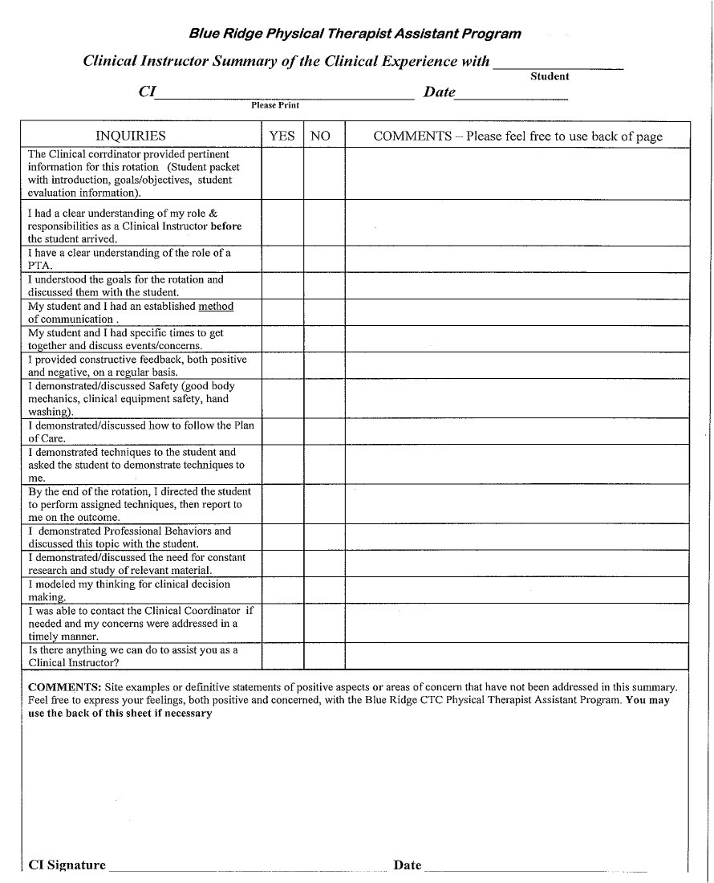
CI summary of clinical experience

Slide 6
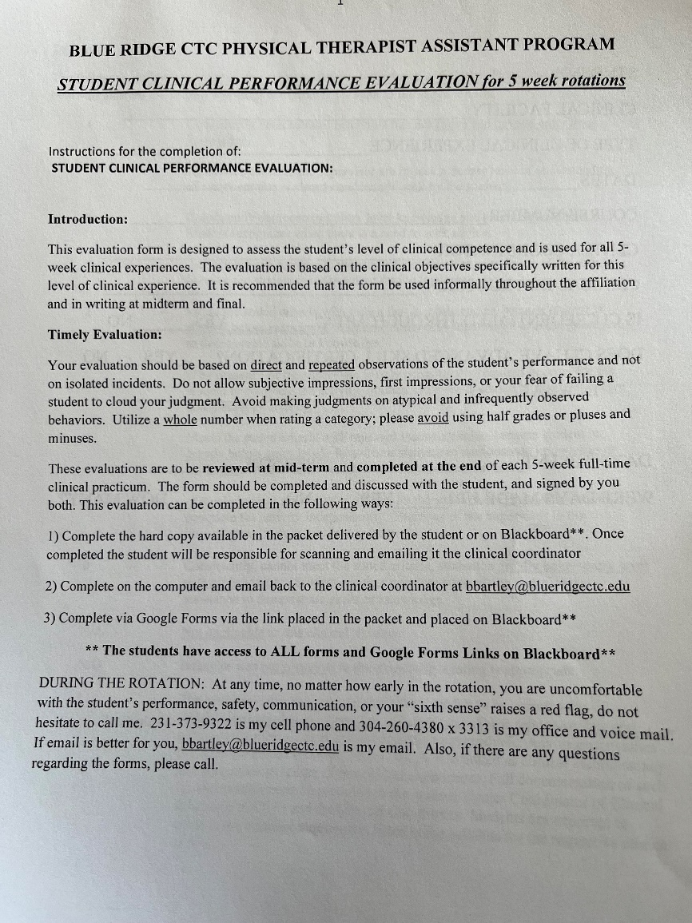
Student Clinicial Performance Eval

Slide 7
Questions or concerns:
Contact PTA Clinical Coordinator (Mark Noll) at 304-260-4380 Ext. 3313, if urgent, please use my cell @ 301-730-7125.
mnoll@blueridgectc.edu
PTA Program Coordinator (Dr.
Chrystal McDonald) at 304-260-4380 ext. 3408.

Slide 8
Thank You!
On behalf of the Blue Ridge Community & Technical College PTA program, we would like to thank you for taking your time to participate in this vital role for our students.

Slide 9
Quiz
What paperwork MUST be completed and signed by CI
at the end of Clinical Rotation?
  Graduation survey
  Student Clinical Performance Evaluation and CI Summary
of Clinical Experience
  CI Abbreviated Resume and Student Clinical Performance Evaluation

Slide 10
Quiz
To Qualify as a clinical instructor for our PTA program, how many years of experience MUST you have?
  6 months
  2 years
  1 year
  No specified amount

Slide 11
Quiz
Clinical instructors should evaluate skills and knowledge level, while providing productive feedback?
  Yes
  No

Slide 12
Quiz
5. If you have any questions or concerns regarding the Clinical education experience, list below the name and phone number of who you would contact?

