Slide 1


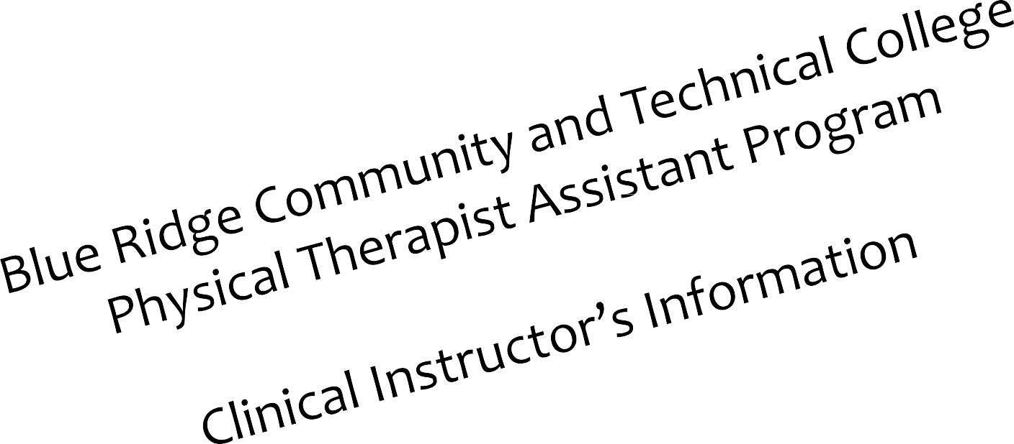


Slide 2
Goals & Objectives
Describe The PTA Program
Explain The Roles & Responsibilities of the “Clinical Instructor (CI)”
Reviewing PTA clinical paperwork
Contacts for questions or concerns

Slide 3
Clinical Instructor’s Roles
Resource – provide knowledge from a field experience not available to student
Have had 1 year experience
Supervisor – Oversee treatment, evaluate skill and knowledge level
Coach – Cheer success, encourage improvement, provides guidance for positive patient care.

Slide 4
Student Clinical Performance Eval

Slide 5
Questions or concerns:
Contact PTA Clinical Coordinator (Mark Noll) at 304-260-4380 Ext. 3313, if urgent, please use my cell @ 301-730-7125.
mnoll@blueridgectc.edu
PTA Program Coordinator (Dr.
Chrystal McDonald) at 304-260-4380 ext. 3408.
cmcdonal@blueridgectc.edu

Slide 6
Thank You!
On behalf of the Blue Ridge Community & Technical College PTA program, we would like to thank you for taking your time to participate in this vital role for our students.

Slide 7
Quiz:
Can also access at: https://www.blueridgectc.edu/about-blue-ridge/faculty-staff/physical-therapist-assistant-clinical-instructor-quiz/
What paperwork MUST be completed and signed by CI
at the end of Clinical Rotation?
1. Student Clinical Performance Evaluation
2. Reservation form
3. All of the above

Slide 8
Quiz
To Qualify as a clinical instructor for our PTA program, how many years of experience MUST you have?
  6 months
  2 years
  1 year
  No specified amount

Slide 9
Quiz
Clinical instructors should evaluate skills and knowledge level, while providing productive feedback?
  Yes
  No

Slide 10
Quiz
If you have any questions or concerns regarding the Clinical education experience, list below the name and phone number of who you would contact?
___________________________________

